Slide 1
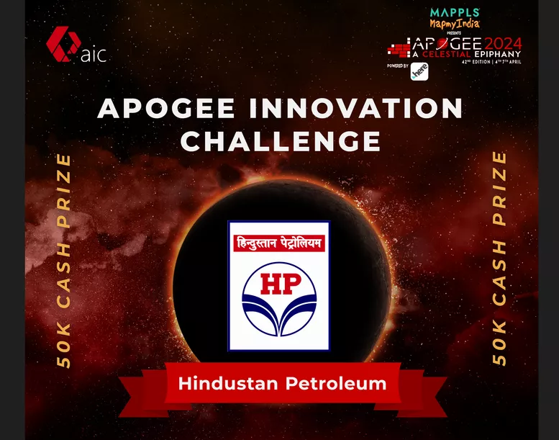
APOGEE INOVATION CHALLENGE PROBLEM STATEMENT:- Supply Operations Distribution Predictive Analytics for HPCL's Supply Operations and Truck Logistics
TEAM NAME:- ROHAN’S TEAM
TEAM MEMBER:- ROHAN NASHIKKAR

Slide 2
ABSTRACT
The abstract highlights the challenges faced by Hindustan Petroleum Corporation Limited (HPCL) in efficiently managing its fuel supply and distribution network across multiple locations. It emphasizes the critical need for precise forecasting of daily fuel demands and the importance of leveraging AI/ML technologies to optimize logistics and enhance customer satisfaction.

Slide 3
PROBLEM STATEMENT
HPCL faces challenges in accurately forecasting daily fuel demands across its network, exacerbated by fluctuating sales volumes, storage capacities, and weather conditions.
Inefficient truck management, compounded by fragmented systems and lack of real-time visibility, leads to suboptimal allocation and utilization of contracted trucks, resulting in delays and customer dissatisfaction.
Integrated solutions are needed to streamline logistical operations, enhance forecasting accuracy, and improve overall efficiency in fuel distribution.

Slide 4
PROPOSED SYSTEM
The proposed system aims to revolutionize HPCL's fuel distribution operations by leveraging advanced technologies and seamless integration of key components.
It entails precise forecasting of fuel demands through AI/ML models, considering historical data and dynamic factors like sales volumes and weather conditions.
Integration of Indent Management, Terminal Automation, and Vehicle Tracking Systems enables real-time monitoring of fuel indents, truck loading status, and movements.
Additionally, the Optimized Logical Allocation module ensures equitable distribution of loads to contracted trucks based on historical trends, transit times, and feedback, maximizing truck utilization and optimizing fuel distribution efficiency.

Slide 5
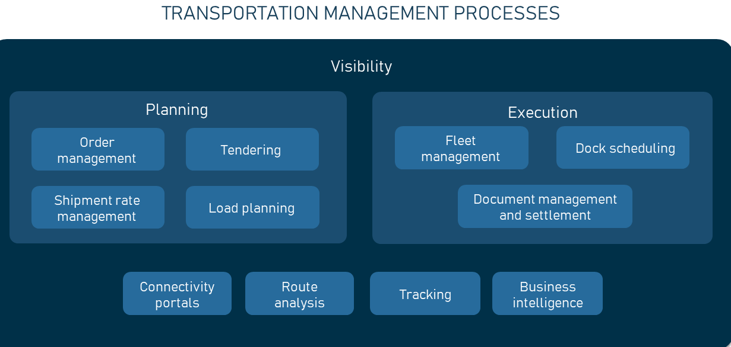
SYSTEM ARCHITECTURE

Slide 6
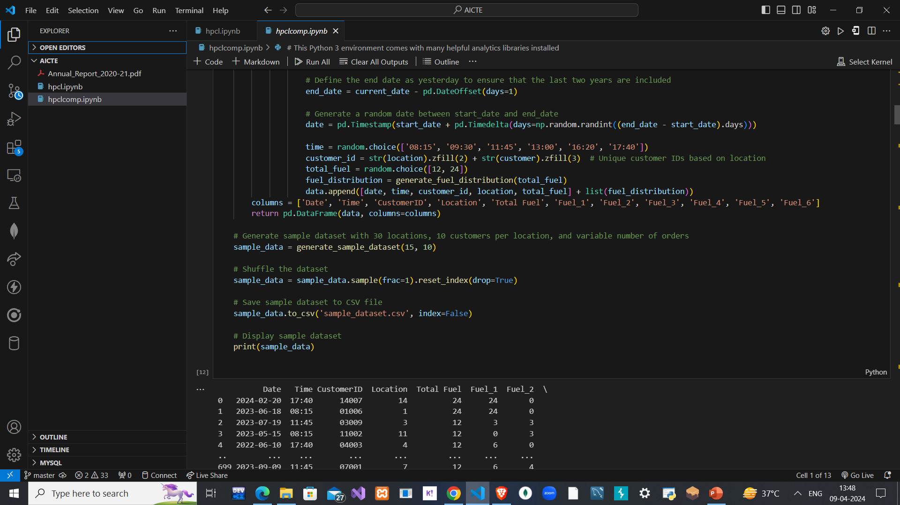
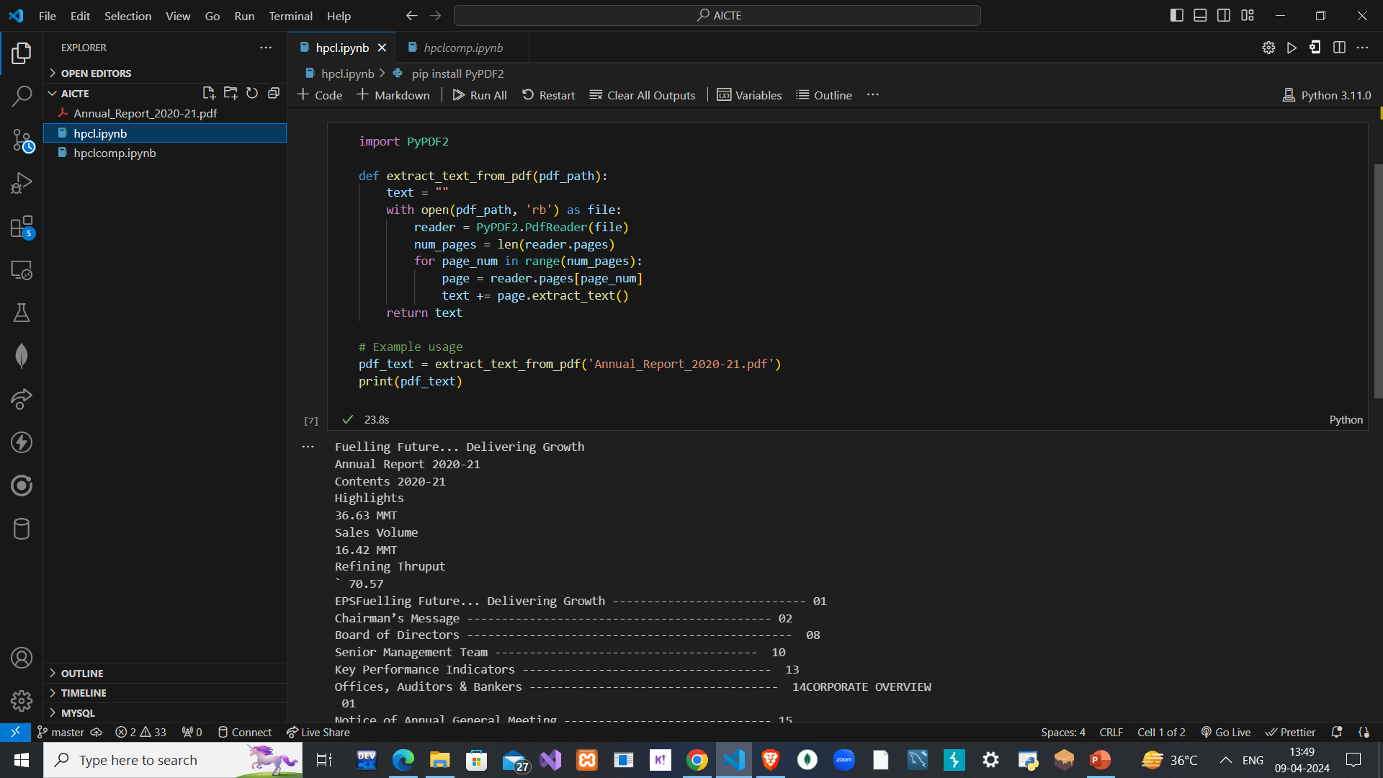
OUTPUTS

Slide 7
CONCLUSION
Thus, to conclude the proposed system not only addresses HPCL's challenges in fuel supply and distribution management but also significantly enhances operational efficiency and cost optimization.
By leveraging AI/ML technologies and integrating key systems, it ensures timely fuel deliveries while reducing operational expenditures through optimized truck allocations and proactive resource management. Looking ahead, further enhancements in data sources, analytics techniques, and feedback mechanisms will enable HPCL to adapt to changing market dynamics, optimize fuel distribution operations, and solidify its position as a leading fuel supplier in the country.

